Slide 1


React JS
(form handling)
Lecture-24

Slide 2
Today’s Agenda
Adding Multiple Fields
Creating Dynamic Keys
Examples
Exercises

Slide 3
Handling Multiple Inputs
We can control the values of more than one input field by doing the following:
Create a key for every input control in this.state
Add name attribute to every input control with its value set to the corresponding key name set in this.state
In the event handler , instead of directly using the key-name , use [evt.target.name] which will give the name of the currently edited input control
In this way we will have to create only one event handler for all the input controls.

Slide 4
Exercise
Create a Contact which displays 3 textboxes for inputting username , email and password and soon as the user types data in these textboxes , the state must be updated it should be reflected on the page.
Finally when the user submits the form all the data he has filled must be shown in an alert

Slide 5
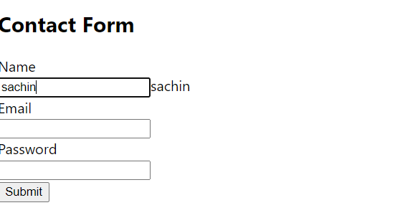
Desired Output

Slide 6
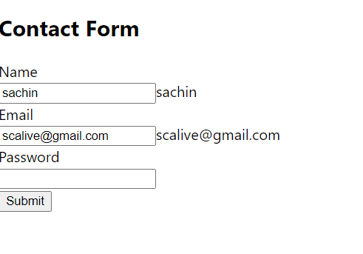
Desired Output

Slide 7
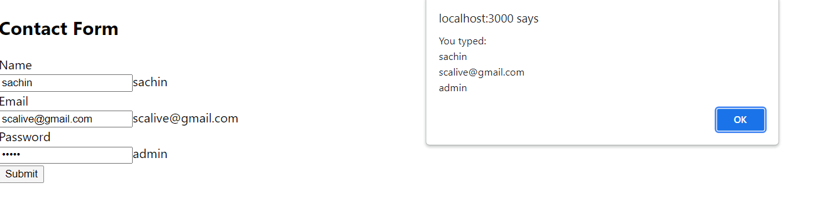
Desired Output

Slide 8
Solution
ContactForm.js
import React, { Component } from "react";
class ContactForm extends Component {
constructor(props) {
super(props);
this.state = { username: "", useremail: "", userpwd: "" };
this.handleChange = this.handleChange.bind(this);
this.handleSubmit = this.handleSubmit.bind(this);
}
handleChange(evt) {
this.setState({ [evt.target.name]: evt.target.value });
}
handleSubmit(evt) {
evt.preventDefault();
alert(
"You typed:\n" +
this.state.username +
"\n" +
this.state.useremail +
"\n" +
this.state.userpwd
);
this.setState({ username: "", useremail: "", userpwd: "" });
}

Slide 9
Solution
ContactForm.js
render() {
return (
<div>
<h2>Contact Form</h2>
<form onSubmit={this.handleSubmit}>
<label htmlFor="name">Name</label>
<br />
<input
id="name"
type="text"
name="username"
value={this.state.username}
onChange={this.handleChange}
/>
<span>{this.state.username}</span>
<br />
<label htmlFor="mailid">Email</label>
<br />
<input
id="mailid"
type="email"
name="useremail"
value={this.state.useremail}
onChange={this.handleChange}
/>
<span>{this.state.useremail}</span>
<br />

Slide 10
Solution
ContactForm.js
<label htmlFor="pwd">Password</label>
<br />
<input
id="pwd"
type="password"
name="userpwd"
value={this.state.userpwd}
onChange={this.handleChange}
/>
<span>{this.state.userpwd}</span>
<br />
<button>Submit</button>
</form>
</div>
);
}
}
export default ContactForm;

Slide 11
Solution
App.js
import React, { Component } from "react";
import ContactForm from "./ContactForm";
class App extends Component {
render() {
return (
<div>
<ContactForm />
</div>
);
}
}
export default App;

Slide 12
Exercise
Modify the ProductList app by making the following changes
Alongwith the list of product names also display quantity for each product as well as a delete button
These product names and quantities be passed from App.js
As usual , on clicking a button the corresponding product must be deleted
Also provide a form to input a new product and quantity and add it to the existing product list on form submission

Slide 13
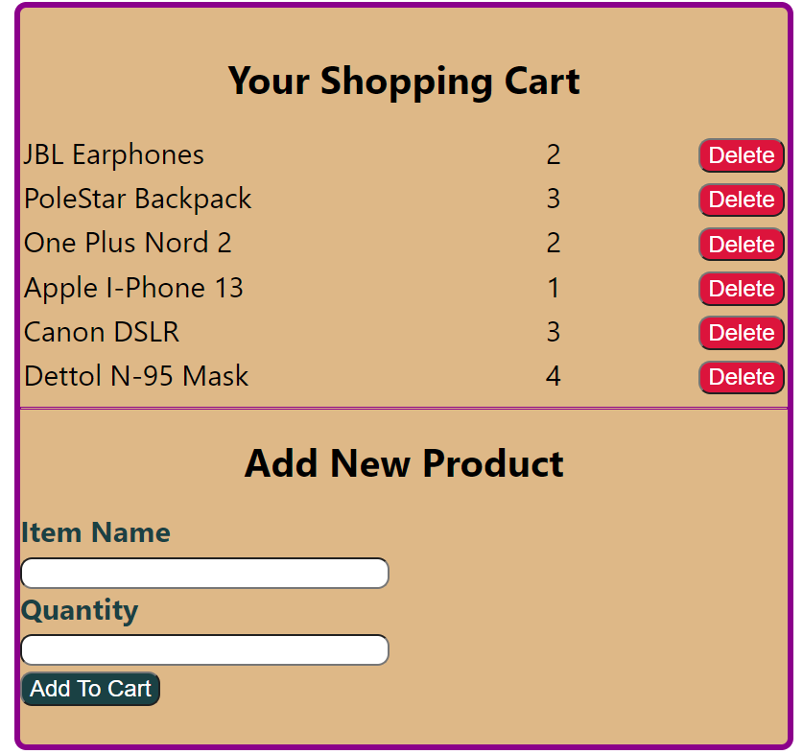
Desired Output
Initial Output

Slide 14
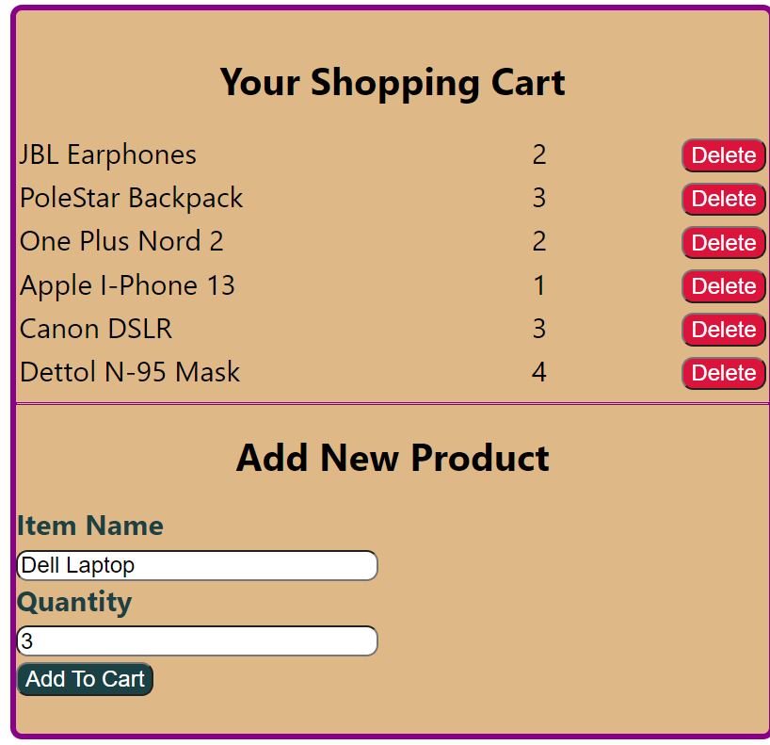
Desired Output
User Is Adding A New Product

Slide 15
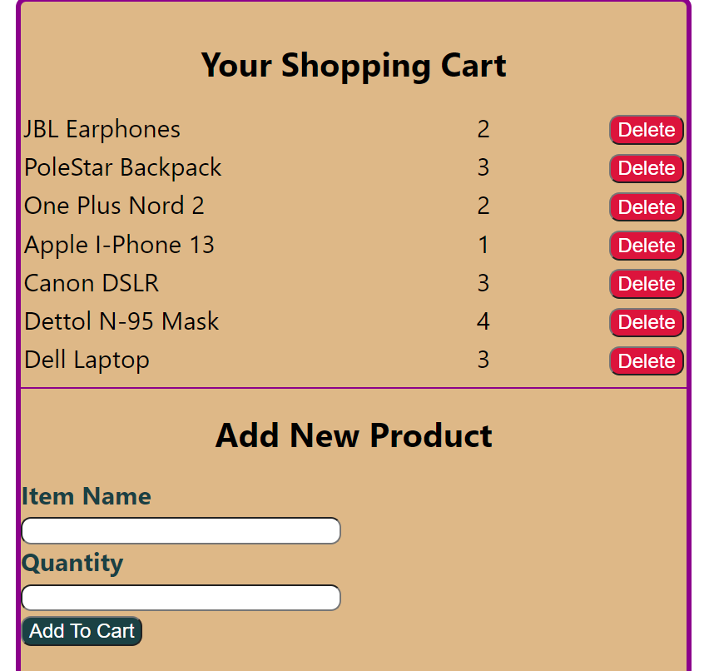
Desired Output
After clicking Add To Cart button

